Slide 1
ARTIFICIAL INTELLIGENCE
8
Fuzzy Logic
Handayani Tjandrasa

Slide 2
DEFINISI
Fuzzy logic:
Cara untuk menyatakan variasi atau ketidaktepatan (tidak mutlak) dalam logika
Misal dalam bahasa alami:
"If it is sunny and warm today, I will drive fast"
Linguistic variables:
Temp: {freezing, cool, warm, hot}
Cloud Cover: {overcast, partly cloudy, sunny}
Speed: {slow, fast}

Slide 3
True/False Variables
King(Richard) ∧ Greedy(Richard) ⇒ Evil(Richard)
“Richard is greedy” is True or False: Greedy(Richard) ∈{0,1}

Slide 4
Fuzzy Sets
Variabelnya dapat mempunyai nilai dalam batasan [0,1]
Misal: Greedy(Richard) = 0.7
Fuzzy Linguistic Variables: digunakan untuk menyatakan nilai yang bervariasi dalam suatu spektrum
Misal:
Temp: {Freezing, Cool, Warm, Hot}
Membership Function: Fungsi keanggotaan untuk menyatakan derajat kebenaran
Contoh: “How warm is it?”

Slide 5
Membership Functions
Temp: {Freezing, Cool, Warm, Hot}
Derajat kebenaran atau keanggotaan (membership)

Slide 6
Membership Functions
Seberapa dingin 36 F° ?
30% Cool dan 70% Freezing

Slide 7
Fuzzy Disjunction
A∨B max(A, B)
(A∨B = C) ⇒ (C = 0.75)
Fuzzy Conjunction
A∧B min(A, B)
(A∧B = C) ⇒ (C = 0.375)

Slide 8
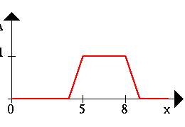
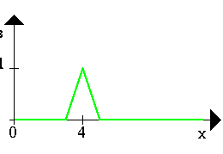
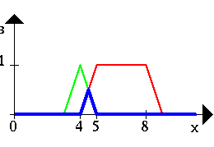
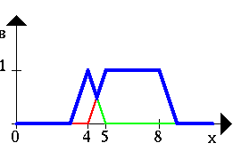
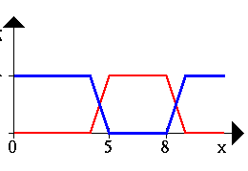
Contoh
A B
A ∧ B A ∨ B ¬A

Slide 9
Struktur Kontroler
Fuzzification
Petakan variabel input dalam nilai fuzzy
Inference Mechanism
Pendekatan reasoning dan deduksi aksi kontrol
Defuzzification
Konversi nilai fuzzy output ke aksi kontrol

Slide 10
Contoh Input: Temp & Cover Output: Speed
Temp: {Freezing, Cool, Warm, Hot}
Cover: {Sunny, Partly, Overcast}
Speed: {Slow, Fast}

Slide 11
Rules
If it's Sunny and Warm, drive Fast
Sunny(Cover)∧Warm(Temp)⇒ Fast(Speed)
If it's Cloudy and Cool, drive Slow
Cloudy(Cover)∧Cool(Temp)⇒ Slow(Speed)

Slide 12
Perhitungan kecepatan
Berapa besar kecepatan bila:
65 F°
25 % Cloud Cover ?

Slide 13
Fuzzification: Berapa besar kecepatan bila temp. 65 F° dan 25 % tertutup awan?
65 F° ⇒ Cool = 0.4, Warm= 0.7
25% Cover ⇒Sunny = 0.8, Cloudy = 0.2

Slide 14
If it's Sunny and Warm, drive Fast
Sunny(Cover)∧Warm(Temp)⇒Fast(Speed)
0.8 ∧ 0.7 = 0.7
⇒ Fast = 0.7
If it's Cloudy and Cool, drive Slow
Cloudy(Cover)∧Cool(Temp)⇒Slow(Speed)
0.2 ∧ 0.4 = 0.2
⇒ Slow = 0.2
Speed = weighted mean
= (2*25+7*75)/(9)
= 63.8 mph

Slide 15
Rule Base
Air Temperature
Set cold {50, 0, 0}
Set cool {65, 55, 45}
Set just right {70, 65, 60}
Set warm {85, 75, 65}
Set hot {∞, 90, 80}
Fan Speed
Set stop {0, 0, 0}
Set slow {50, 30, 10}
Set medium {60, 50, 40}
Set fast {90, 70, 50}
Set blast {∞, 100, 80}

Slide 16
Rules
Air Conditioning Controller:
IF Cold then Stop
If Cool then Slow
If OK then Medium
If Warm then Fast
IF Hot then Blast

Slide 17
Fuzzy Air Conditioner

Slide 18
TERIMA KASIH

